Slide 1
Processor Extensions

Slide 2
Simple Jump Instruction
Move the Program Counter by more than 1; even by a negative number
Call it JUMP JUMP instruction – ???? bbbb bbbb 0000 where bbbb bbbb is an 8-bit signed number
So JUMP would add bbbb bbbb to the PC

Slide 3
Control-Unit and Datapath for Our Programmable Processor
D_addr 8
addr
D
addr
data
I
16
D_wr
256
x
16
5
wr
PC
IR
W_data
R_data
clr
up
Id
16
16
RF_s
1
0
Becomes (signed) Adder
s
16-bit
2
x
1
16
RF_W_addr
4
W_addr
W_data
RF_W_wr
W_wr
RF_Ra_addr
4
Ra_addr
Controller
RF_Ra_rd
Ra_rd
16
x
16
Datapath
RF_Rb_addr
4
Rb_addr
RF
RF_Rb_rd
Rb_rd
16
Ra_data
Rb_data
Alu_s0
16
16
3
A
B
S
ALU
Control unit
16
Detailed connections

Slide 4
JUMP State
Init
PC_up = 1
IR_ld = 1
PC_clr = 1
Fetch
PC_up = bbbb bbbb
JUMP
Decode
HALT
NOOP
LOAD_A
STORE
ADD
SUB
RF_W_addr = IR[3:0]
RF_W_wr = 1
RF_Ra_addr=IR[11:8]
RF_ra_rd = 1
RF_Rb_addr = IR[7:4]
RF_rb_rd = 1
ALU_s0 = 2
LOAD_B
RF_W_addr = IR[3:0]
RF_W_wr = 1
RF_Ra_addr=IR[11:8]
RF_ra_rd = 1
RF_Rb_addr = IR[7:4]
RF_rb_rd = 1
ALU_s0 = 1
D_addr = IR[11:4]
RF_s = 1
RF_W_addr = IR[3:0
D_addr = IR[7:0]
D_wr = 1
RF_Ra_addr=IR[11:8]
RF_ra_rd = 1
D_addr = IR[11:4]
RF_s = 1
RF_W_addr = IR[3:0]
RF_W_wr = 1

Slide 5
Jump If True (JNZ) Instruction
Move the Program Counter by more than 1 if some register evaluates to TRUE
Call it JNZ (Jump if Not Zero - ???) JNZ instruction – ???? bbbb bbbb rrrr where bbbb bbbb is an 8-bit signed number and rrrr points to one of our Register File registers
So JNZ would add bbbb bbbb to the PC if rrrr is not zero
We are going to need some feedback from the ALU to the Controller

Slide 6
Control-Unit and Datapath for Our Programmable Processor
D_addr 8
addr
D
addr
data
I
16
D_wr
256
x
16
5
wr
PC
IR
W_data
R_data
clr
up
Id
16
16
RF_s
1
0
Becomes Adder/Subtractor
s
16-bit
2
x
1
16
RF_W_addr
4
W_addr
W_data
RF_W_wr
W_wr
RF_Ra_addr
4
Ra_addr
Controller
RF_Ra_rd
Ra_rd
16
x
16
Datapath
RF_Rb_addr
4
Rb_addr
RF
RF_Rb_rd
Rb_rd
16
Ra_data
Rb_data
Alu_s0
16
16
3
A
B
S
ALU
Control unit
Flags
16
Detailed connections

Slide 7
JUMP State
If (~Z)
PC_up = bbbb bbbb
Init
PC_up = 1
IR_ld = 1
PC_clr = 1
Fetch
Z is a ‘zero’ flag from ALU
JNZA
JNZB
Decode
RF_Ra_addr=IR[3:0]
RF_ra_rd = 1
ALU_s0 = 3
HALT
NOOP
LOAD_A
STORE
ADD
SUB
RF_W_addr = IR[3:0]
RF_W_wr = 1
RF_Ra_addr=IR[11:8]
RF_ra_rd = 1
RF_Rb_addr = IR[7:4]
RF_rb_rd = 1
ALU_s0 = 2
LOAD_B
RF_W_addr = IR[3:0]
RF_W_wr = 1
RF_Ra_addr=IR[11:8]
RF_ra_rd = 1
RF_Rb_addr = IR[7:4]
RF_rb_rd = 1
ALU_s0 = 1
D_addr = IR[11:4]
RF_s = 1
RF_W_addr = IR[3:0
D_addr = IR[7:0]
D_wr = 1
RF_Ra_addr=IR[11:8]
RF_ra_rd = 1
D_addr = IR[11:4]
RF_s = 1
RF_W_addr = IR[3:0]
RF_W_wr = 1

Slide 8
Adding Result Flags to ALU
A
B
Control
Lines
Result
Flags
(registered)
S is a function of A and B
Exactly what function
depends on the Control Lines
S

Slide 9
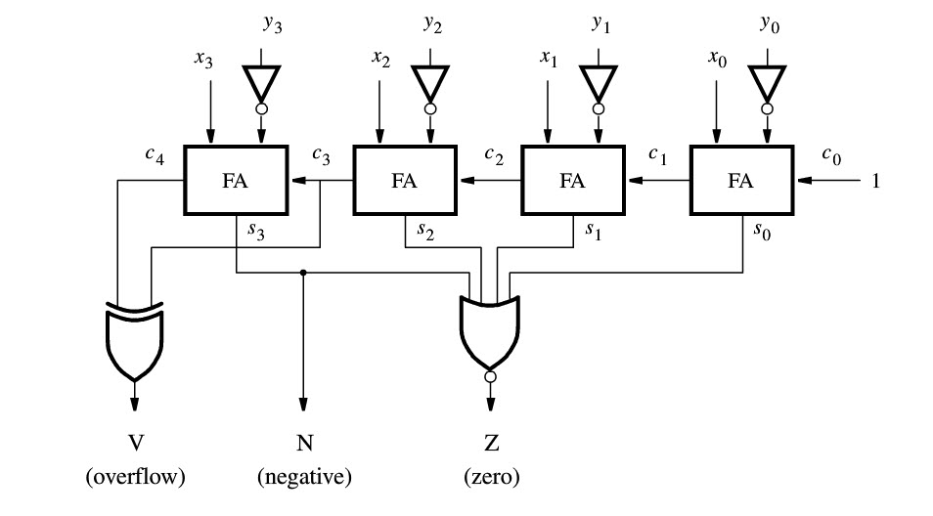
Subtract Circuit from Text
We (you) can show V = carryout ^ x_{n-1} ^ y_{n-1} ^ s_{n-1}
so you don’t need c₃, which is buried in the Adder

Slide 10
Signed Number Overflow
(
+
7
)
0 1 1 1
(
–
7
)
1 0 0 1
+
(
+
2
)
+
0 0 1 0
+
(
+
2
)
+
0 0 1 0
(
+
9
)
1 0 0 1
(
–
5
)
1 0 1 1
c
4
=
0 (carry to bit 4)
c
4
=
0
c
3
=
1 (carry to bit 3)
c
3
=
0
(
+
7
)
0 1 1 1
(
–
7
)
1 0 0 1
+
(
–
2
)
+
1 1 1 0
+
(
–
2
)
+
1 1 1 0
(
+
5
)
1
0 1 0 1
(
–
9
)
1
0 1 1 1
c
4
=
1
c
4
=
1
c
3
=
1
c
3
=
0
Figure 5.14. Examples of determination of overflow.
overflow = c₃ ^ c₄
in general, overflow = c_{n-1} ^ c_{n}

Slide 11
Signed Arithmetic Overflow Problem
Most of the time we’ll implement an adder with a ‘+’:
{Cout,Sum} = A + B + Cin;
So we just have ready access to the inputs and outputs of
the adder:
A
Adder
Sum
B
Cout
Cin

Slide 12
Overflow Equations
claim: c₃ = x₃ ^ y₃ ^ s₃
Let’s see:
x₃ ^ y₃ ^ s₃ = x₃ ^ y₃ ^ (x₃ ^ y₃ ^ c₃)
= (x₃ ^ y₃) ^ (x₃ ^ y₃) ^ c₃
= 0 ^ c₃
= c₃
In general,
c_{n-1} = x_{n-1} ^ y_{n-1} ^ s_{n-1}
so
overflow = c_{n} ^ c_{n-1} = c_{n} ^ x_{n-1} ^ y_{n-1} ^ s_{n-1}
= carryout ^ x_{n-1} ^ y_{n-1} ^ s_{n-1}

Slide 13
n-bit Adder with Carryout and Overflow
module addern( carryin, X, Y, S, carryout, overflow );
parameter n = 32;
input carryin;
input [n-1:0] X, Y;
output reg [n-1:0] S;
output reg carryout, overflow;
always @(X, Y, carryin) begin
{carryout, S} = X + Y + carryin;
overflow = carryout ^ X[n-1] ^ Y[n-1] ^ S[n-1];
end
endmodule

Slide 14
Adding Flags to Our ALU
always @ ( A, B, S ) begin
Co = 0; // default
case ( S )
//…
2: {Co,Q} = A - B; // SUB
3: Q = A; // A
// …
endcase
// calculate the flags
V = Co ^ A[15] ^ B[15] ^ Q[15];
N = Q[15];
Z = ~|Q;
end // always
// register the flags
always @( posedge Clk ) begin
if ( En ) begin
F[0] = Z;
F[1] = N;
F[2] = V;
F[3] = Co;
F[15:4] = 0;
end // enabled
end // sequential loop

Slide 15

Fun With Flags

Slide 16
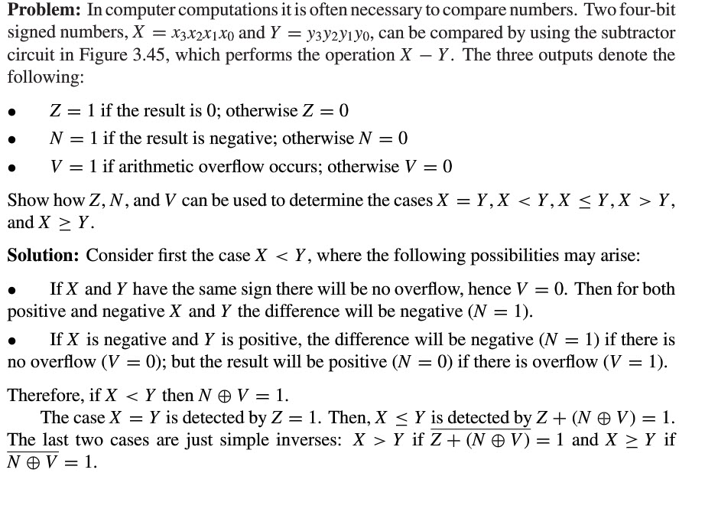
What Else Can We Do With These Flags?

Slide 17
Jump if Less Than (JLT)
If (N ^ V)
PC_up = bbbb bbbb
Init
PC_up = 1
IR_ld = 1
PC_clr = 1
Fetch
N, V are flags from ALU
JLTA
JLTB
Decode
?
HALT
NOOP
LOAD_A
STORE
ADD
SUB
RF_W_addr = IR[3:0]
RF_W_wr = 1
RF_Ra_addr=IR[11:8]
RF_ra_rd = 1
RF_Rb_addr = IR[7:4]
RF_rb_rd = 1
ALU_s0 = 2
LOAD_B
RF_W_addr = IR[3:0]
RF_W_wr = 1
RF_Ra_addr=IR[11:8]
RF_ra_rd = 1
RF_Rb_addr = IR[7:4]
RF_rb_rd = 1
ALU_s0 = 1
D_addr = IR[11:4]
RF_s = 1
RF_W_addr = IR[3:0
D_addr = IR[7:0]
D_wr = 1
RF_Ra_addr=IR[11:8]
RF_ra_rd = 1
D_addr = IR[11:4]
RF_s = 1
RF_W_addr = IR[3:0]
RF_W_wr = 1

Slide 18
We Can Now Do
if statements
for loops
While, repeat, etc.

Slide 19
Subroutine Calls
Need a Stack (LIFO) to store PC so we can get back, registers
Stack Pointer (SP) points to next available slot in the stack
PUSH instruction – put something on the stack (like the PC)
POP instruction – take something off the stack
JSUB (jump to subroutine)
RET (return from subroutine)

Slide 20
Interrupts
Once we have subroutine calls, it’s a short step to Interrupts
A software interrupt (e.g., INT 3)
An exception (like Overflow)
Set up a timer that interrupts when it turns over or any other condition you wish
A hardware interrupt (e.g, if GPIO[19] went from LOW to HIGH)
The addresses of Interrupt ‘subroutines’ (called Interrupt Handlers) are stored somewhere in Instruction Memory

Slide 21
Definitely Not Least: An Assembler
Our program:
0: RF[0] = D[0]
1: RF[1] = D[1]
2: RF[2] = RF[0] + RF[1]
3: D[9] = RF[2]
4: HALT
Becomes: LOAD 0 0 or 0010 00000000 0000b LOAD 1 1 or 0010 00000001 0001b ADD 0 1 2 or 0011 0000 0001 0010b STORE 2 9 or 0001 0010 00001001b HALT or 0101 0000 00000000b
This is what gets stored in Instruction Memory
0x2000
0x2011
0x3012
0x1209
0x5000

